Slide 1

REMOTE CONTROL CAR
Lecturer: Thái Huy Tân
Subject: Mobile Application Development

Slide 2
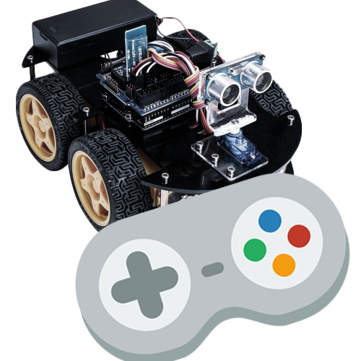

Slide 3
Hello!
Bogeyman Team:
👉 Lâm Tiên Điền An - Leader
👉 Huỳnh Tiến Đạt – Main Coder
👉 Nguyễn Công Trí Nhân – Reporter

Slide 4

Idea
Develop a robot controlled by smartphone
That robot is used to do some jobs in some places too dangerous for humans.

Slide 5
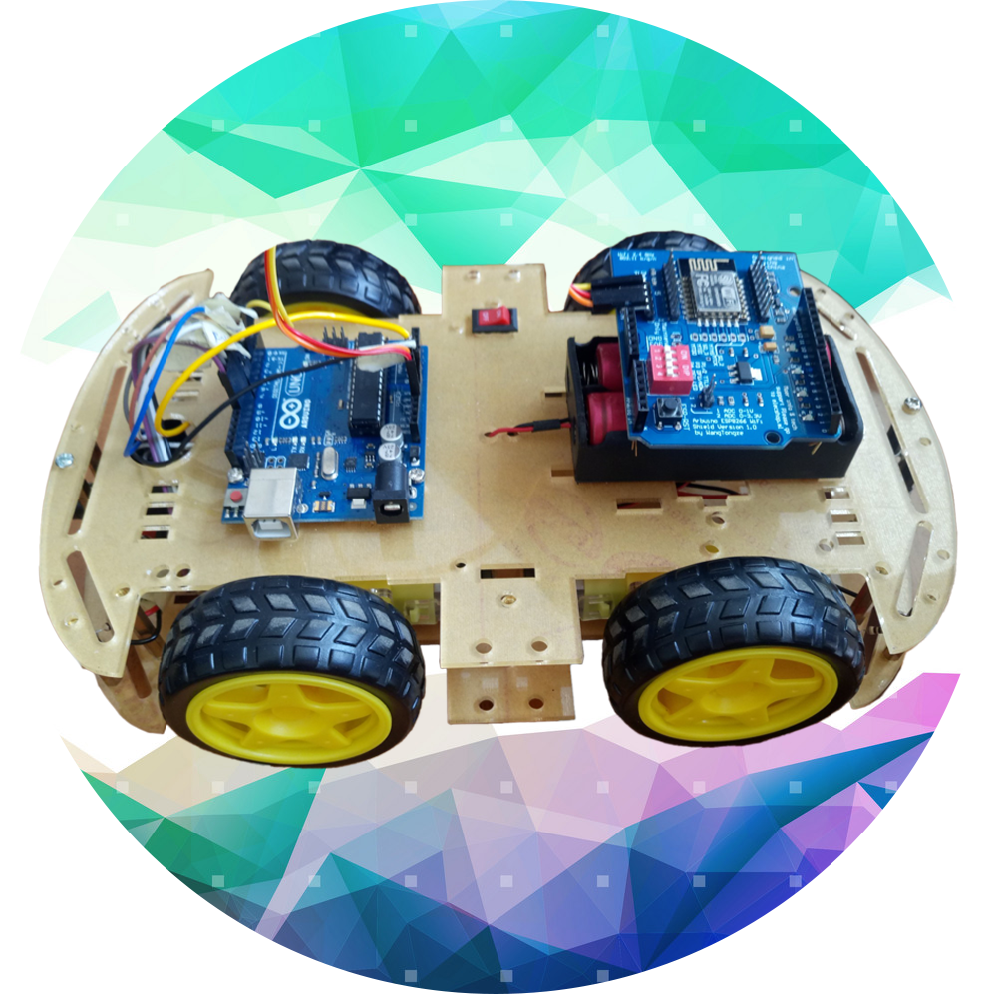
Robot
Control everywhere
Low-Power
Via WiFi connection
Small Size

Slide 6
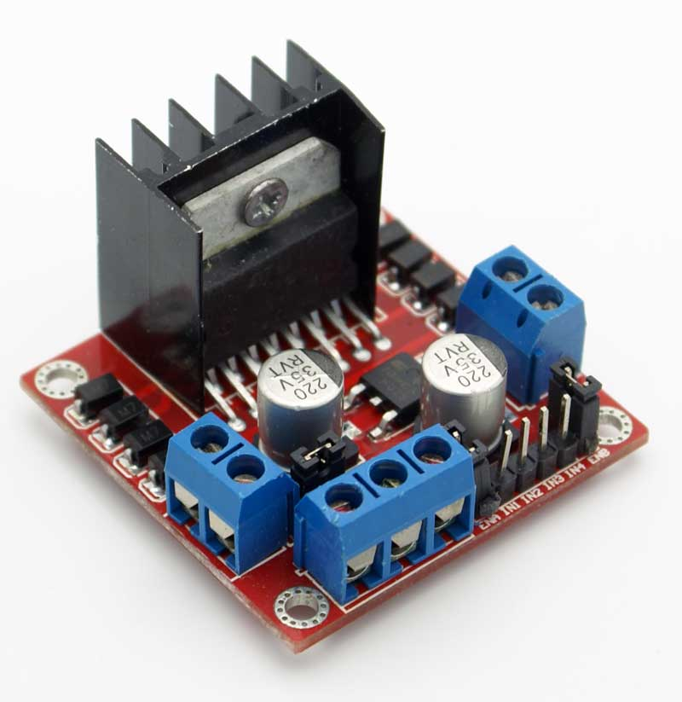
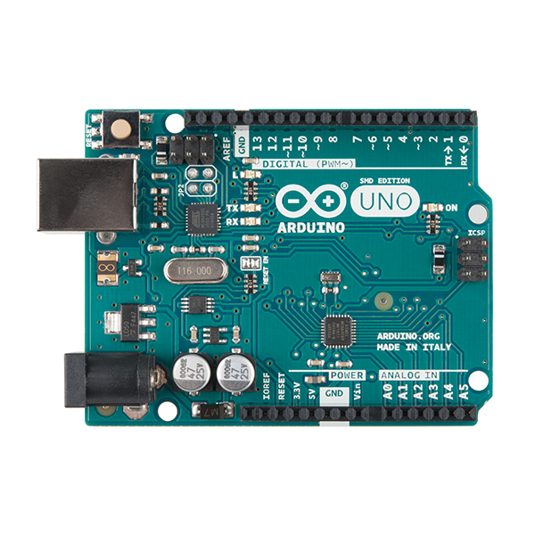
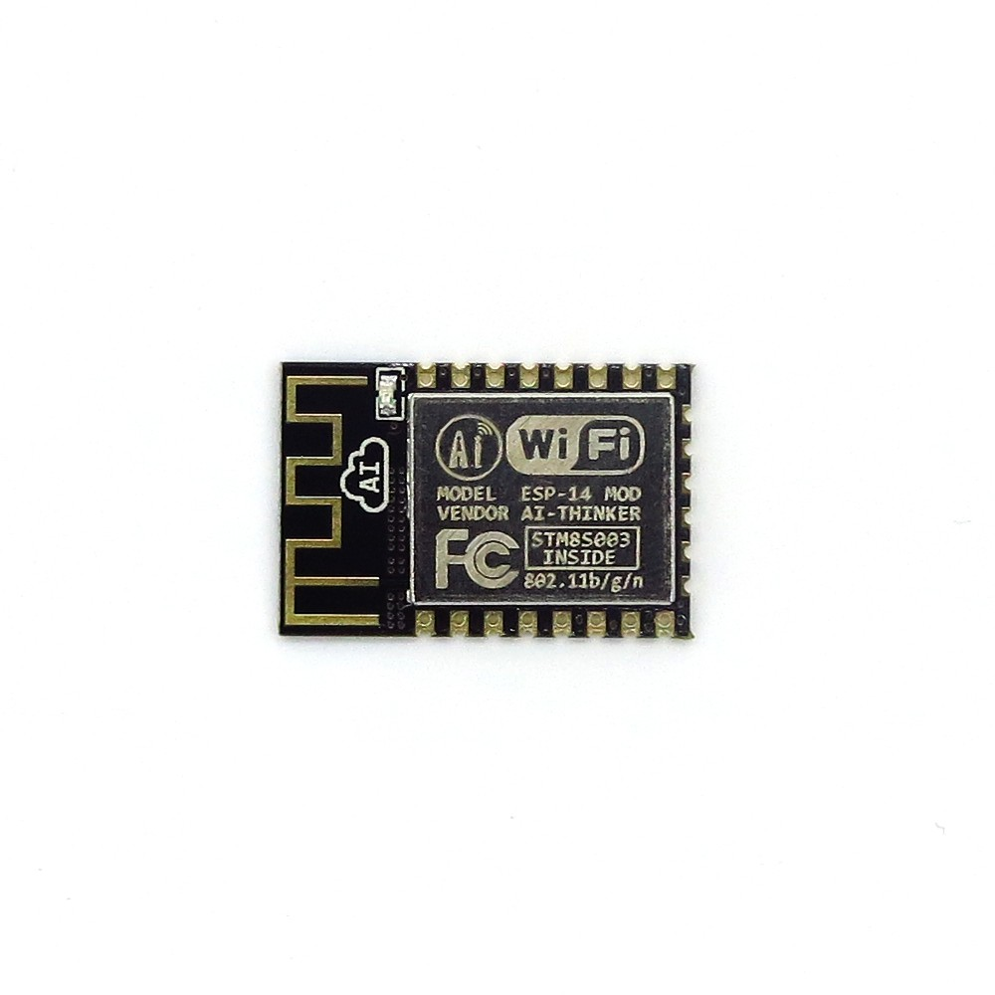
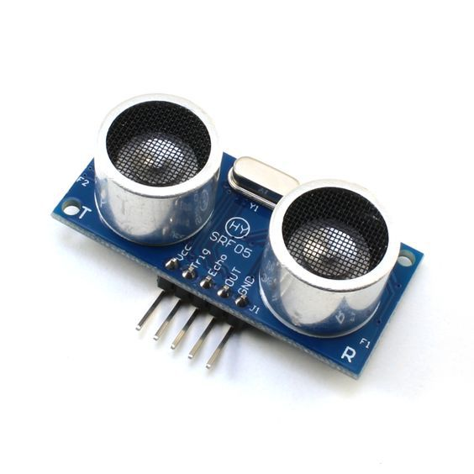

Arduino Uno R3
ESP8266
L298
Sonar SRF 05
Motor
Buzzer & LED

Slide 7
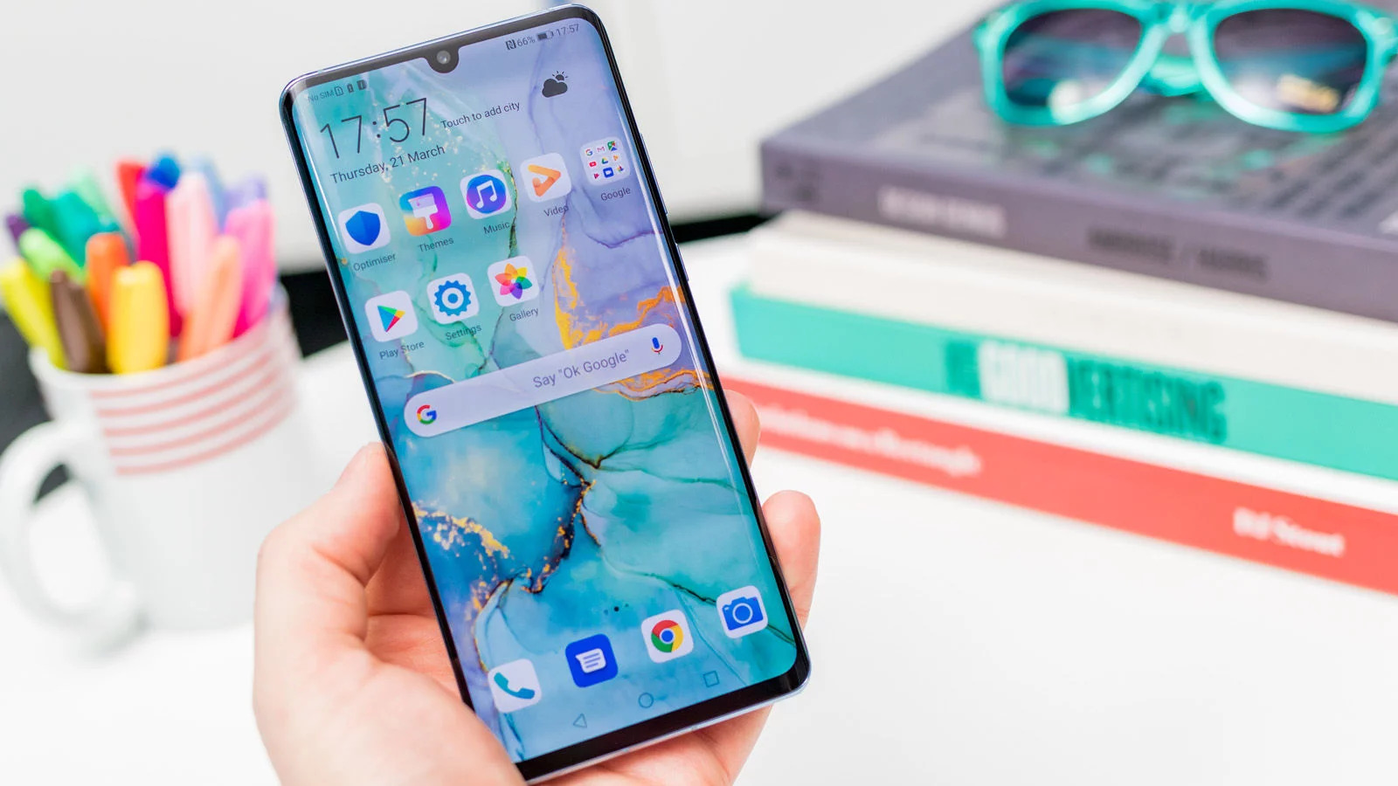
Mobile project

Slide 8
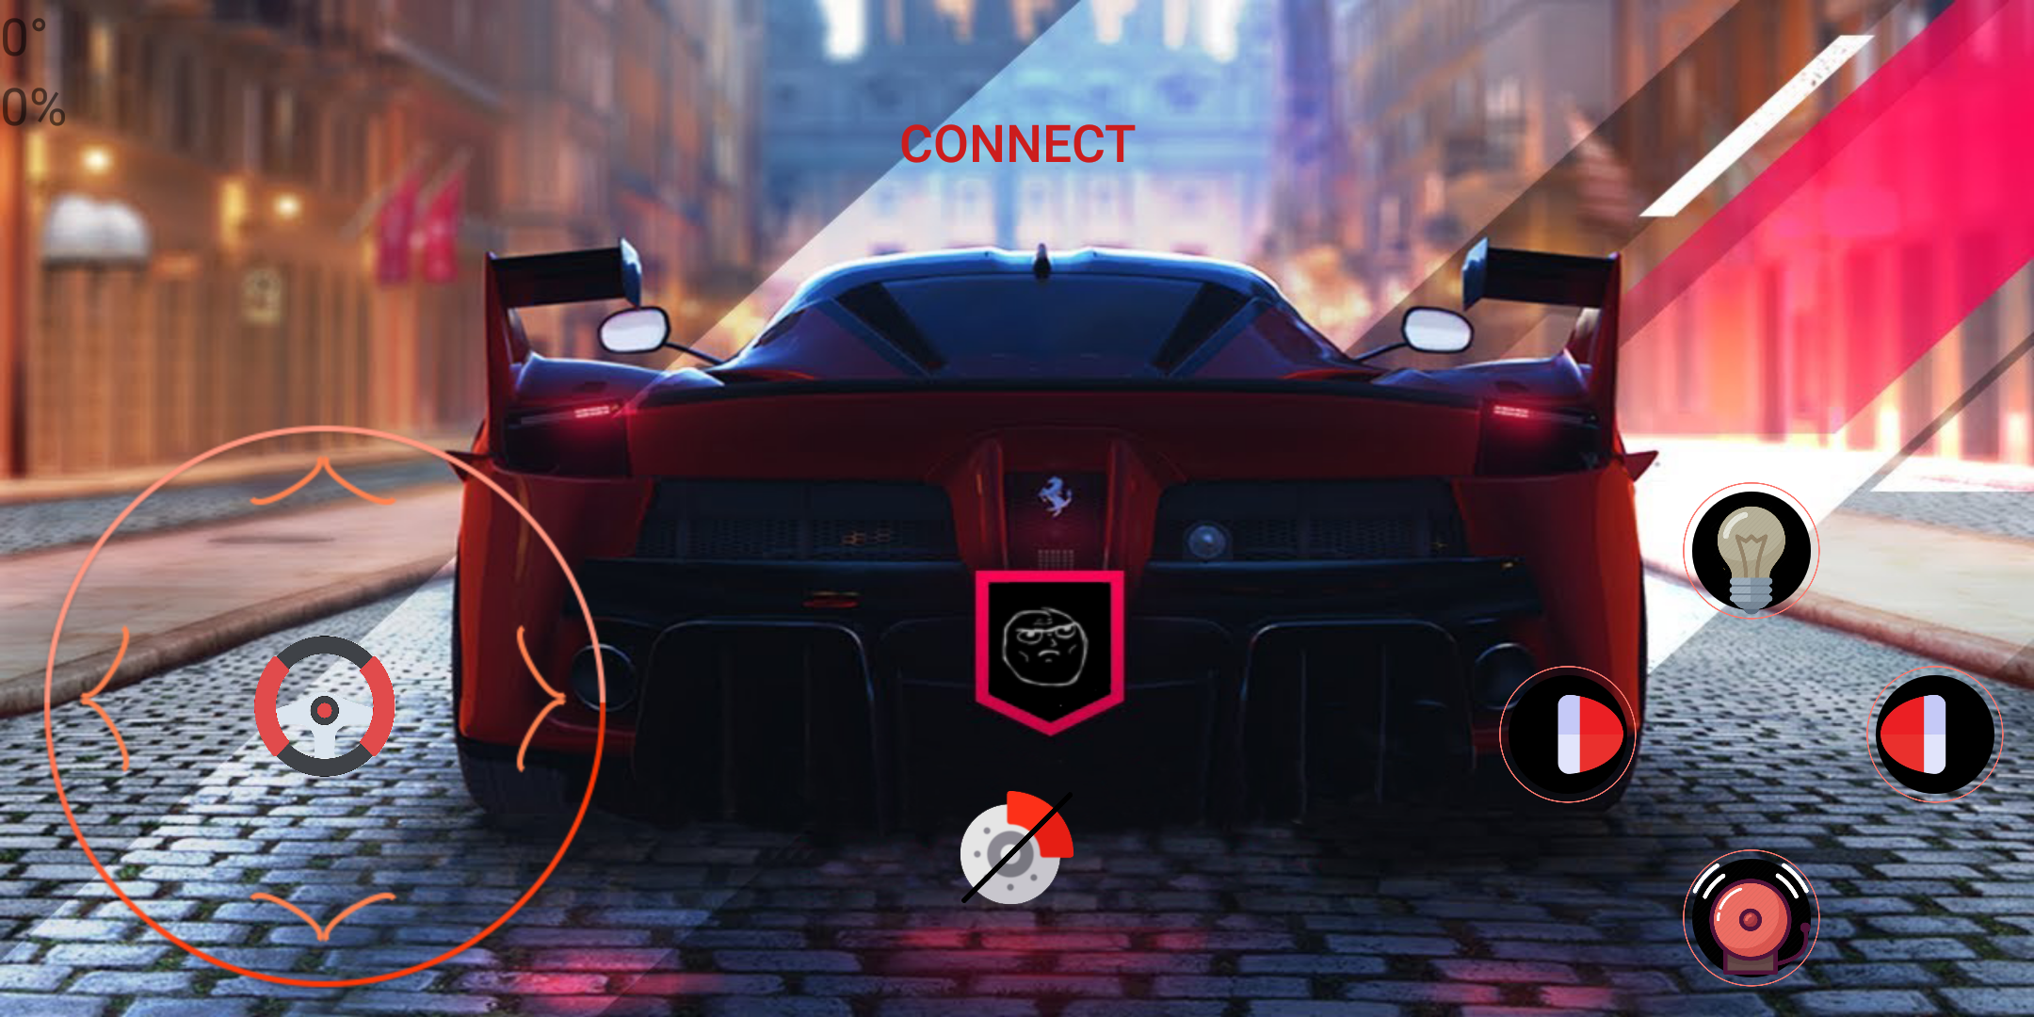
Main Activity

Slide 9
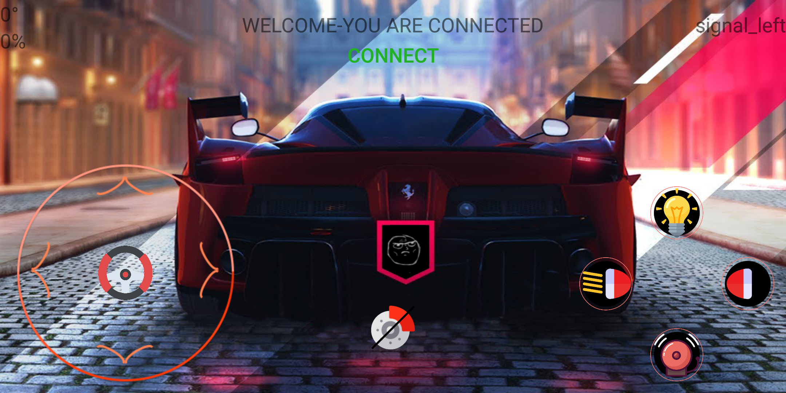
Main Activity

Slide 10

Main Activity

Slide 11
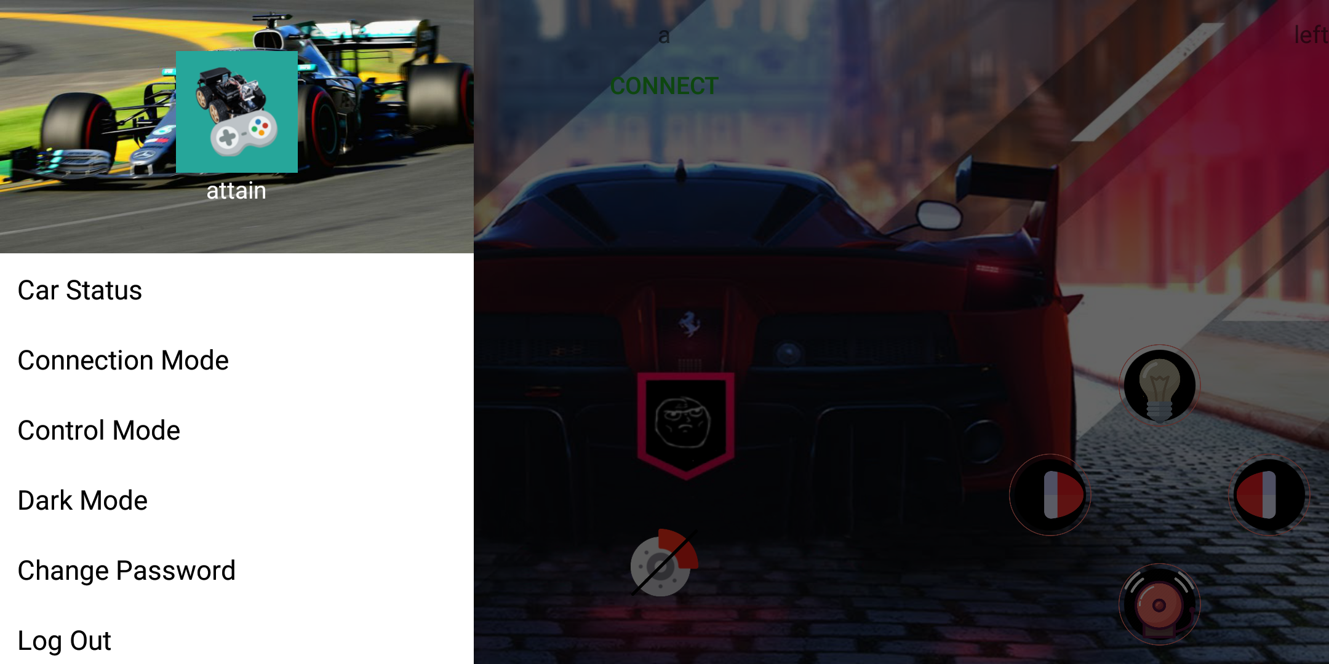
Navigation Bar

Slide 12
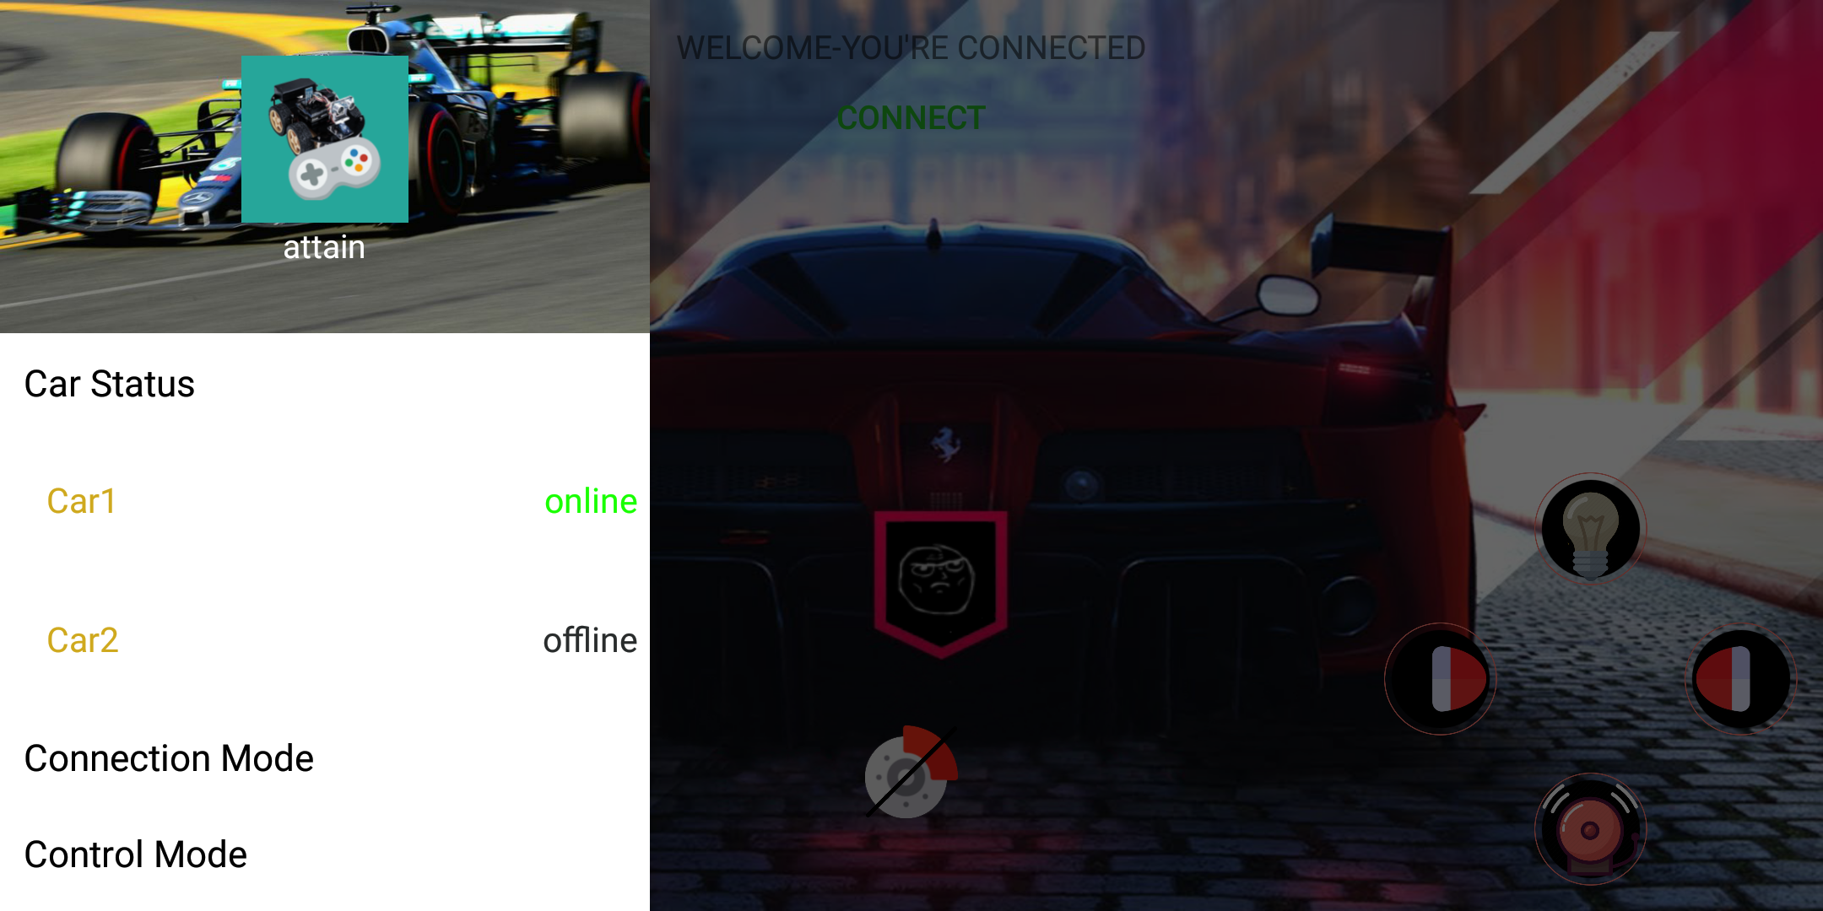
Car List

Slide 13
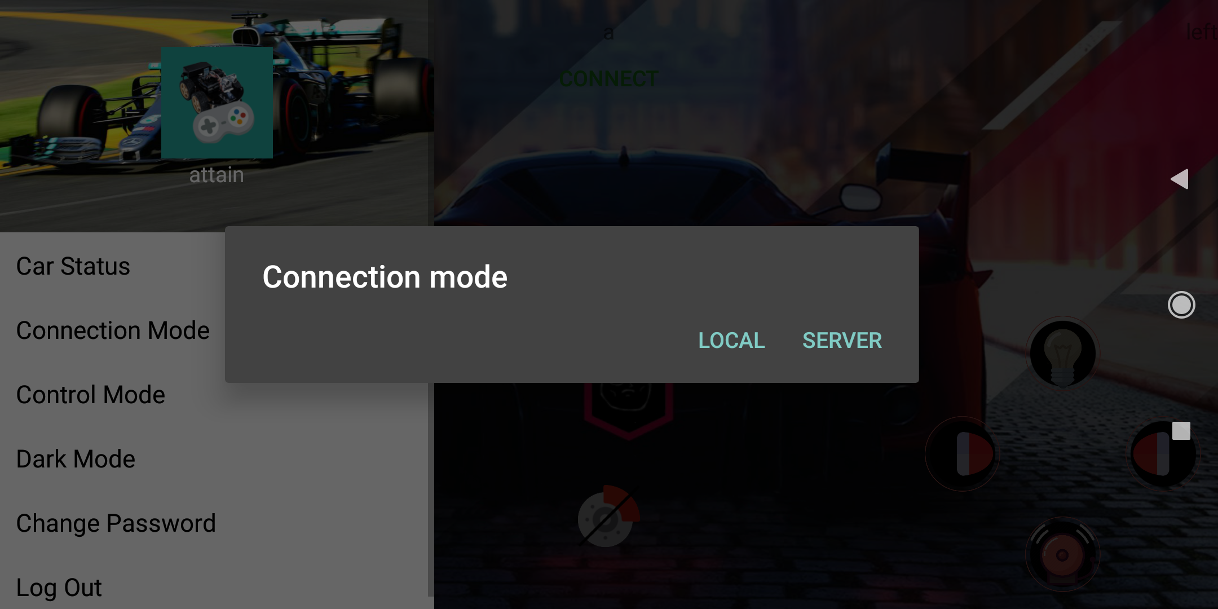
Connection mode

Slide 14
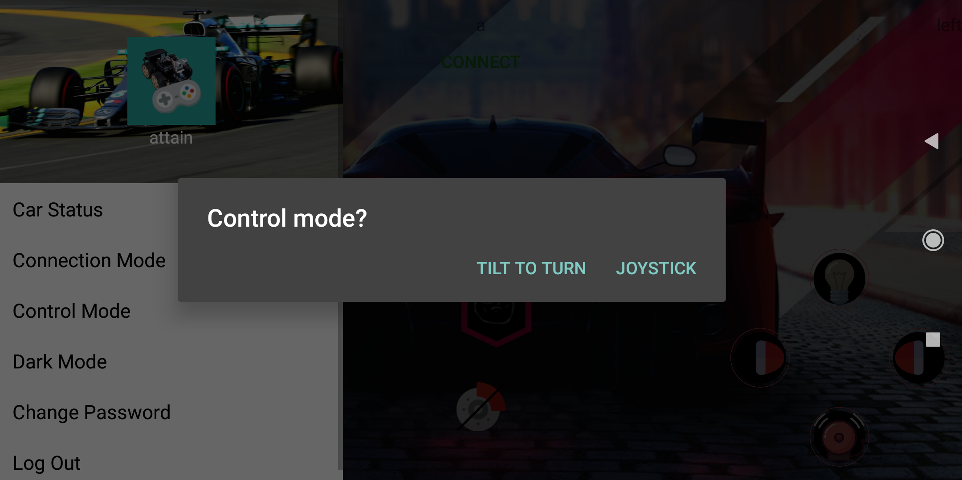
Control mode

Slide 15
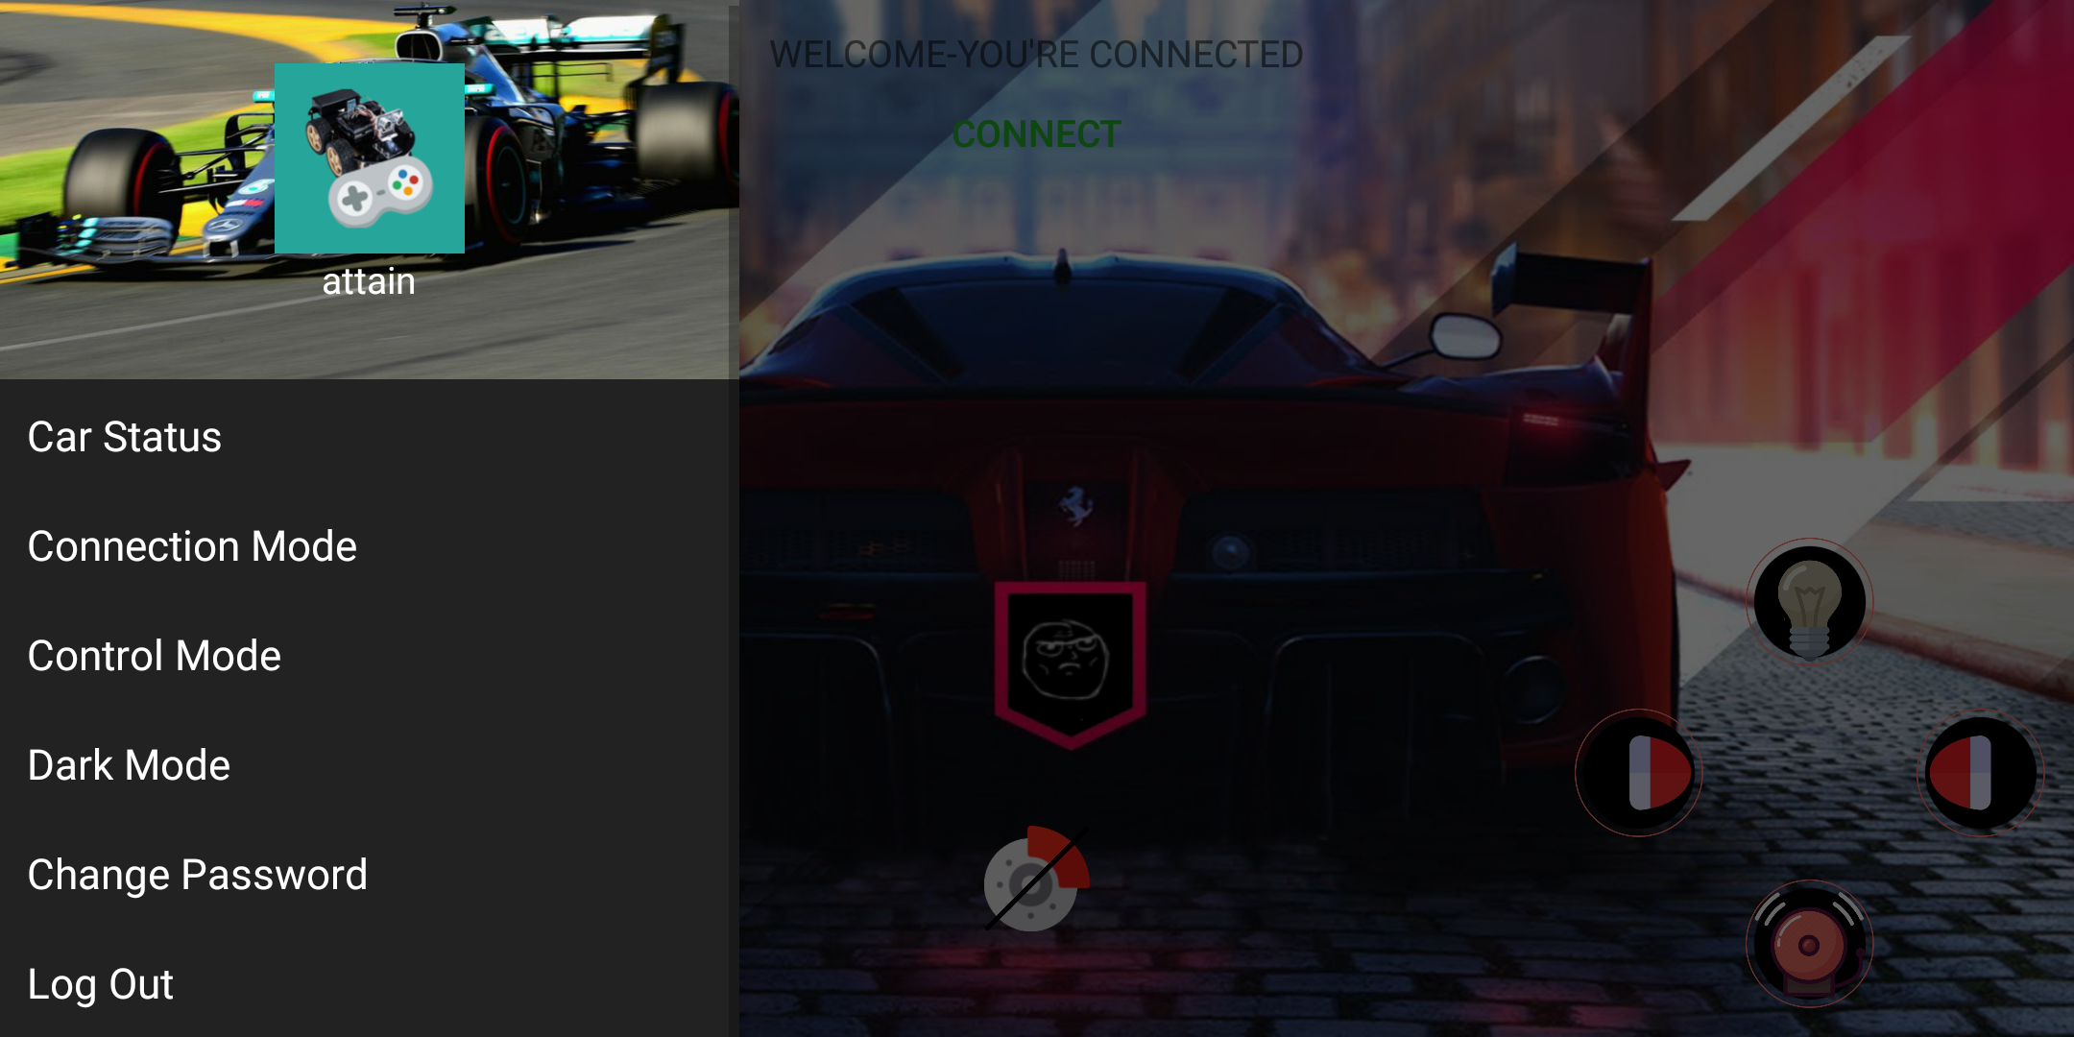
Dark mode

Slide 16
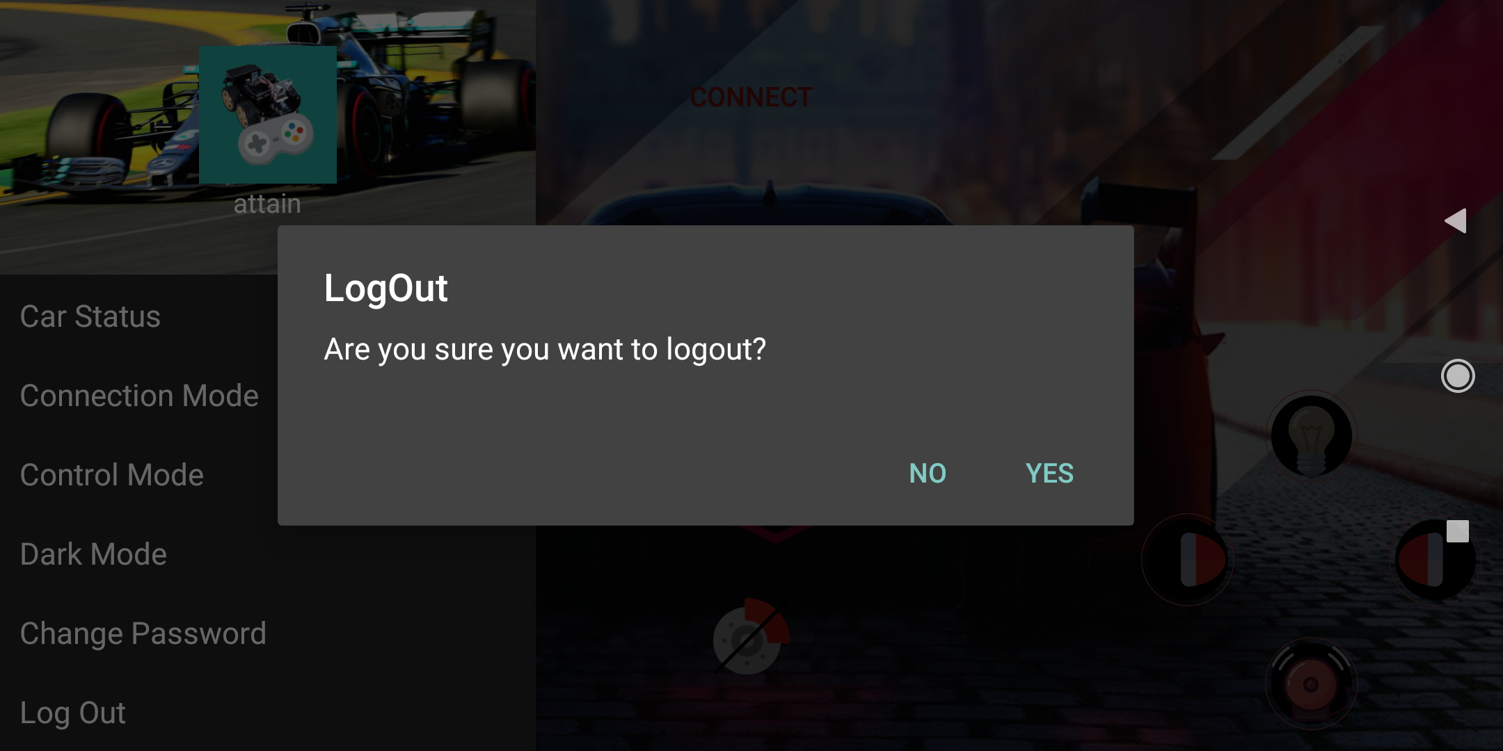
Logout

Slide 17
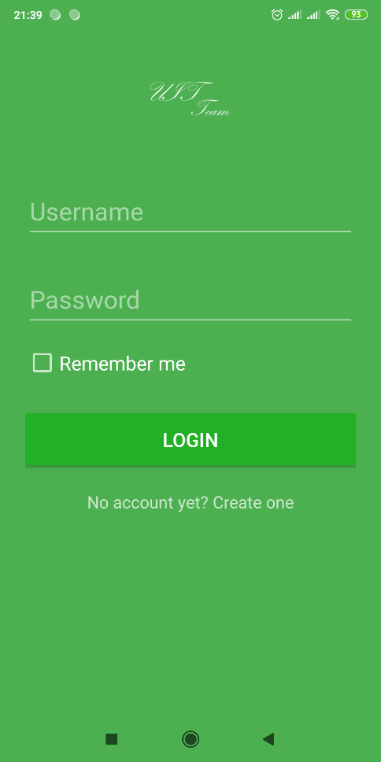
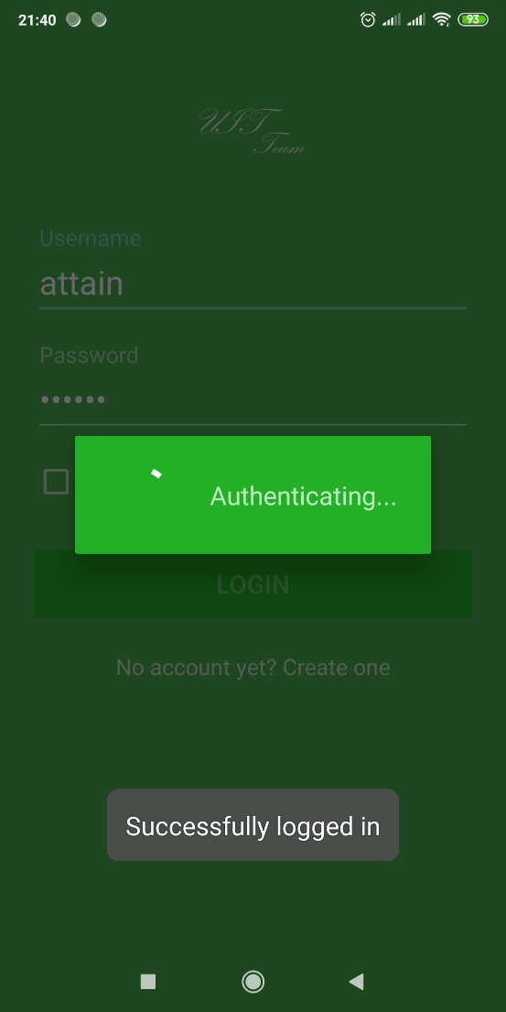
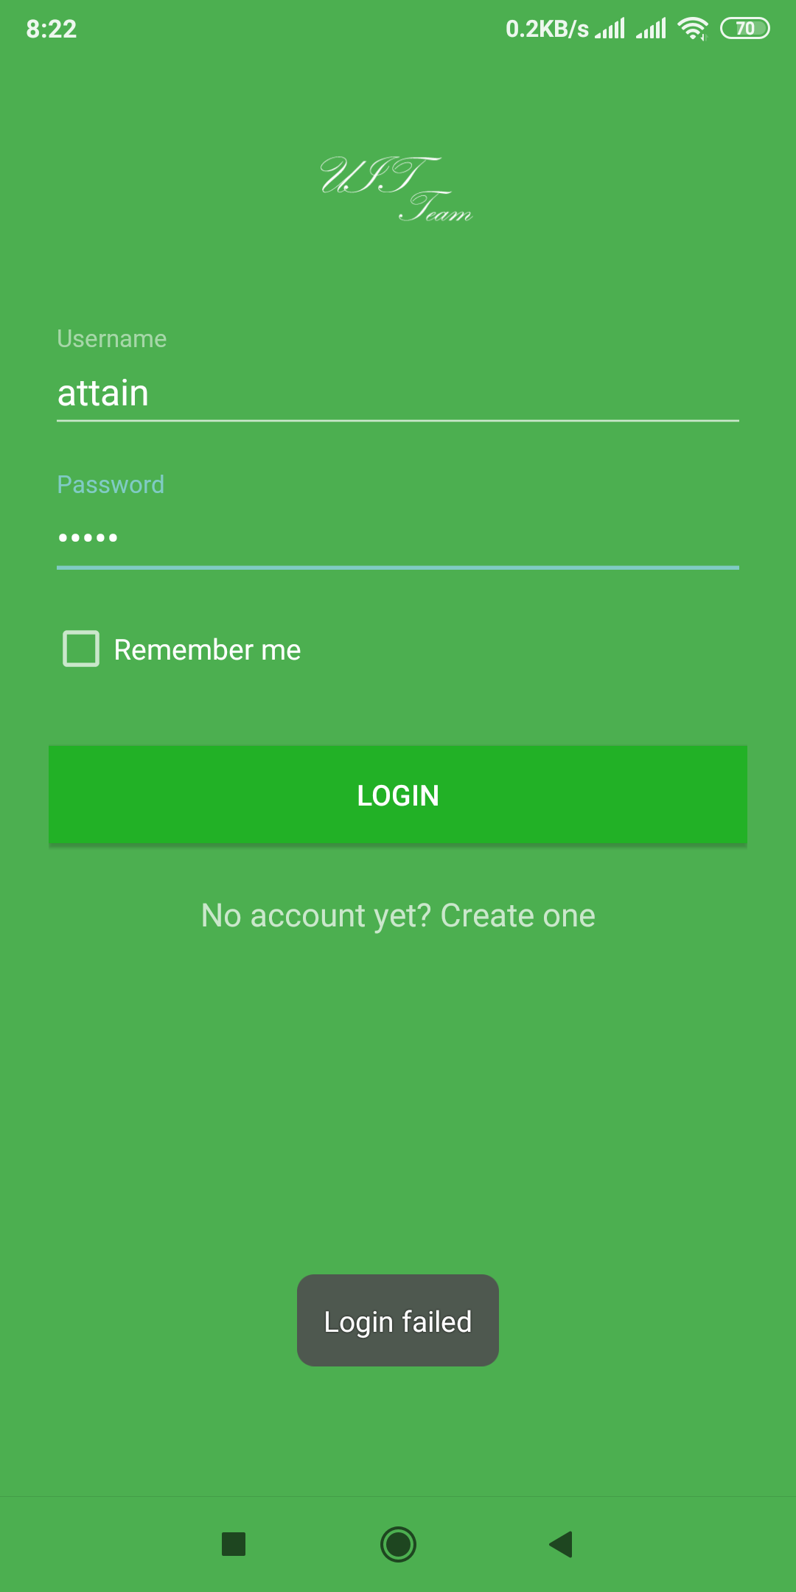
Login Activity

Slide 18
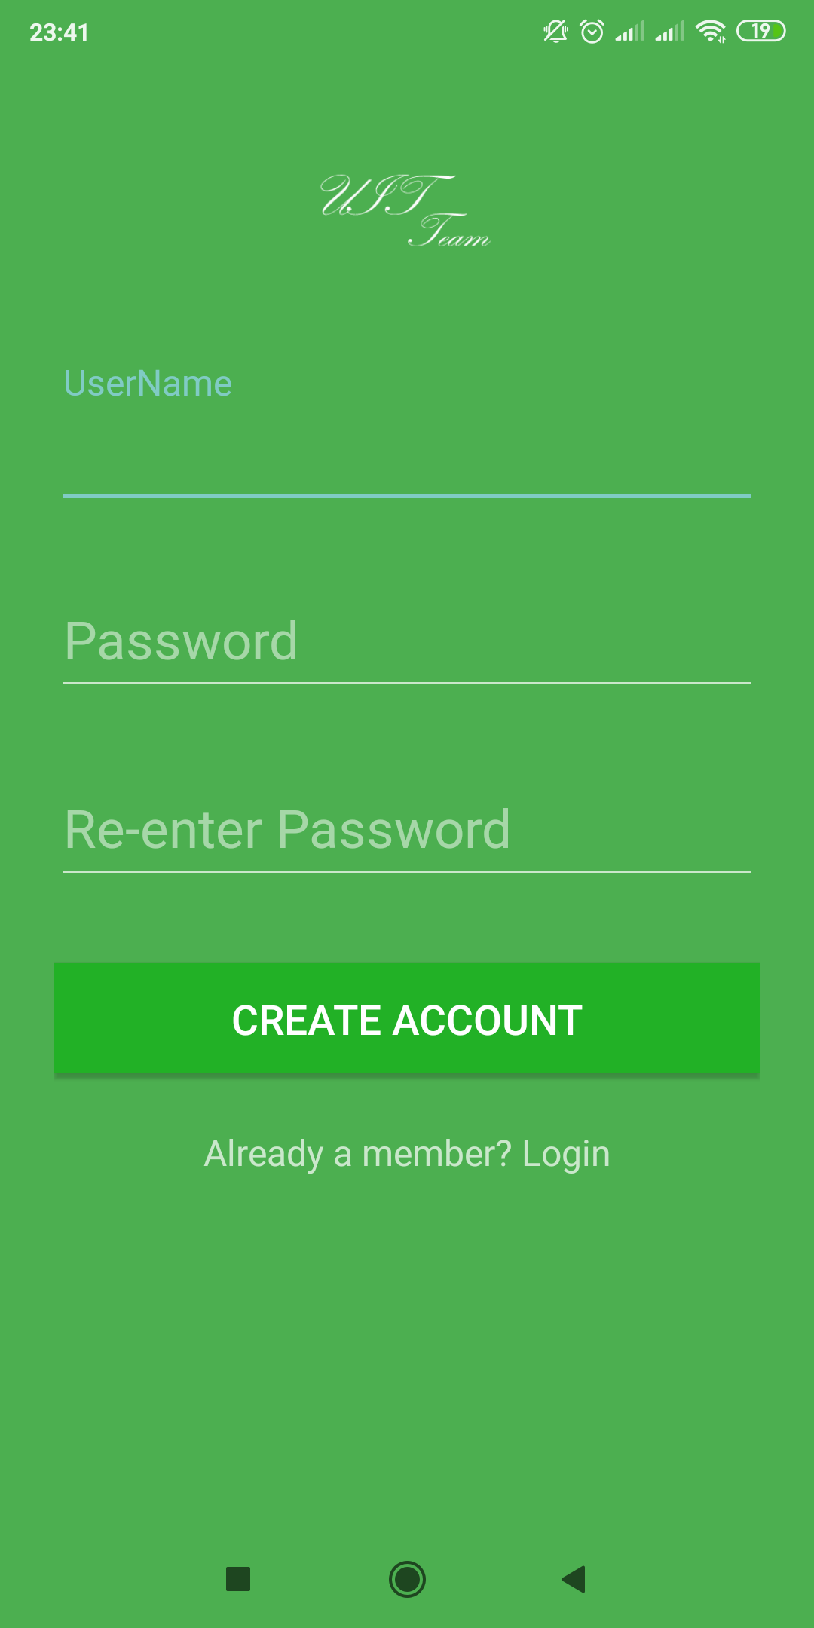
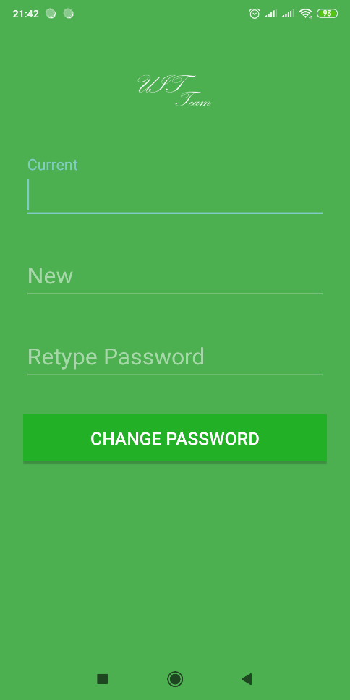
Create Account
Change Password

Slide 19
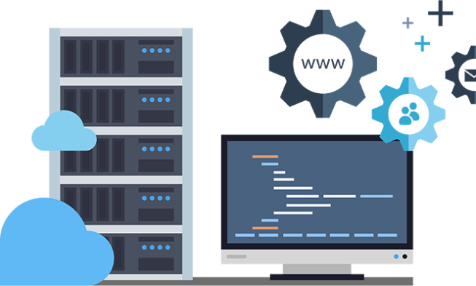
Web server
http://dieukhienxe.tk

Slide 20
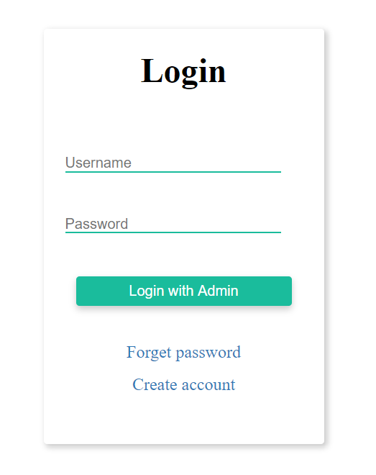

Slide 21
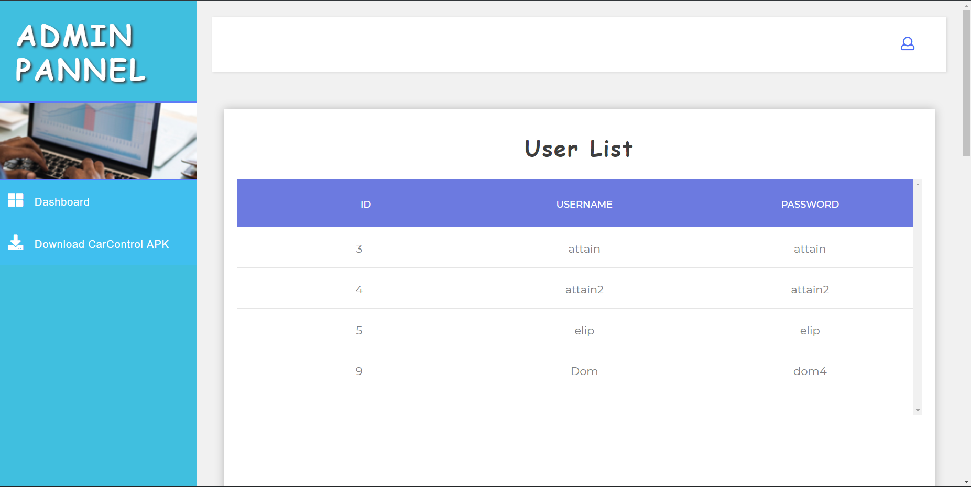

Slide 22
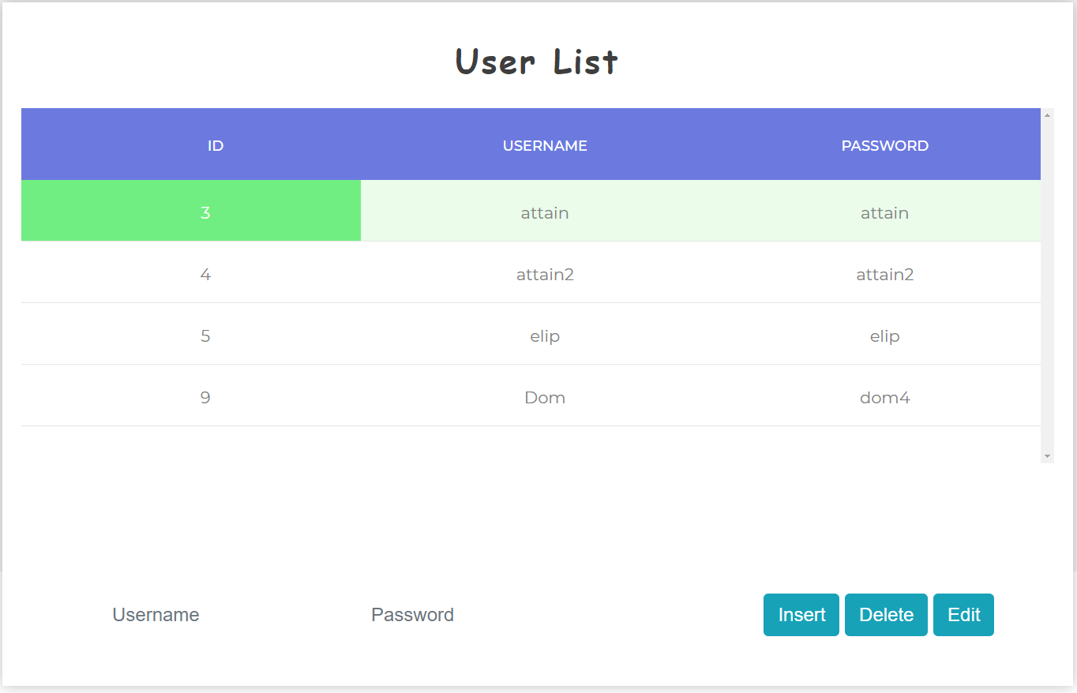

Slide 23
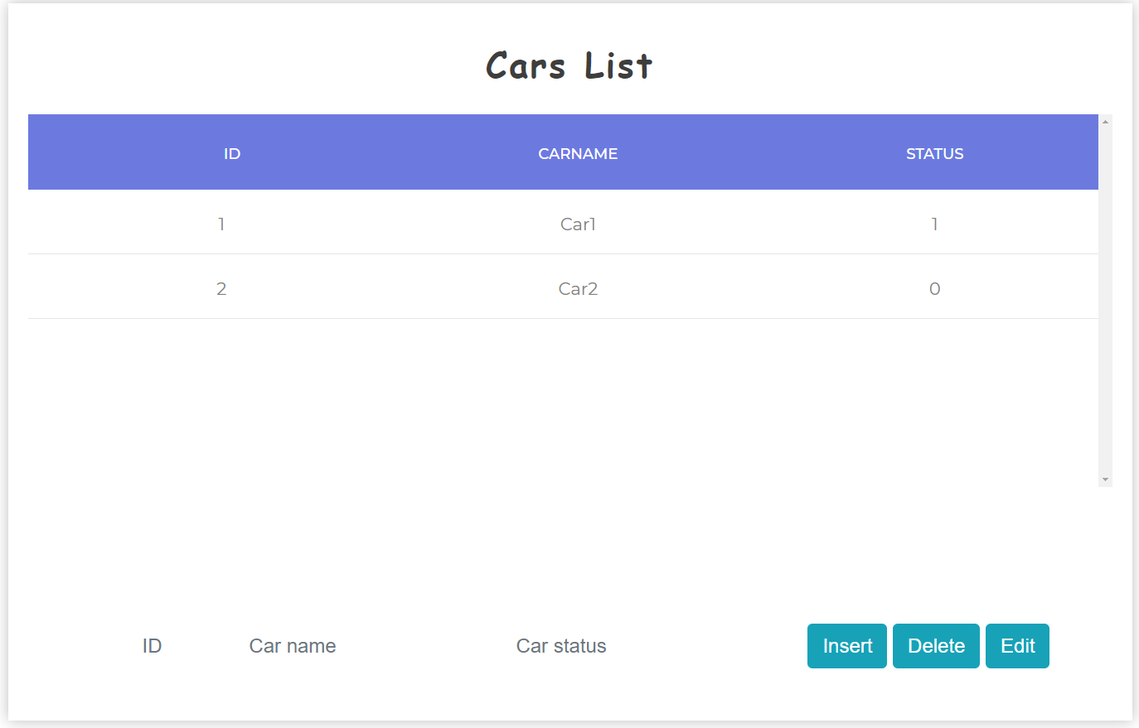
0: offline
1: online
2: busy

Slide 24
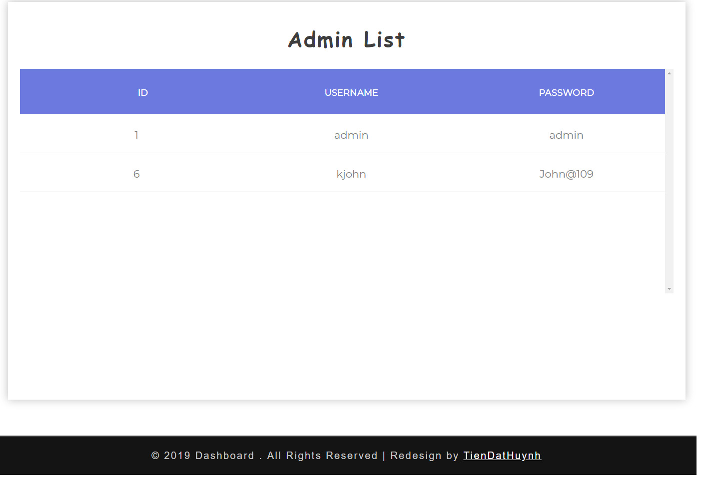

Slide 25
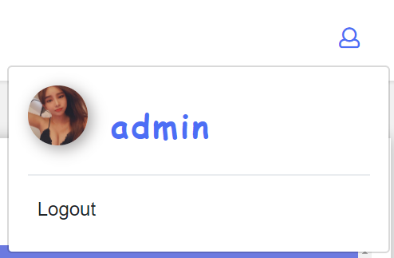

Slide 26
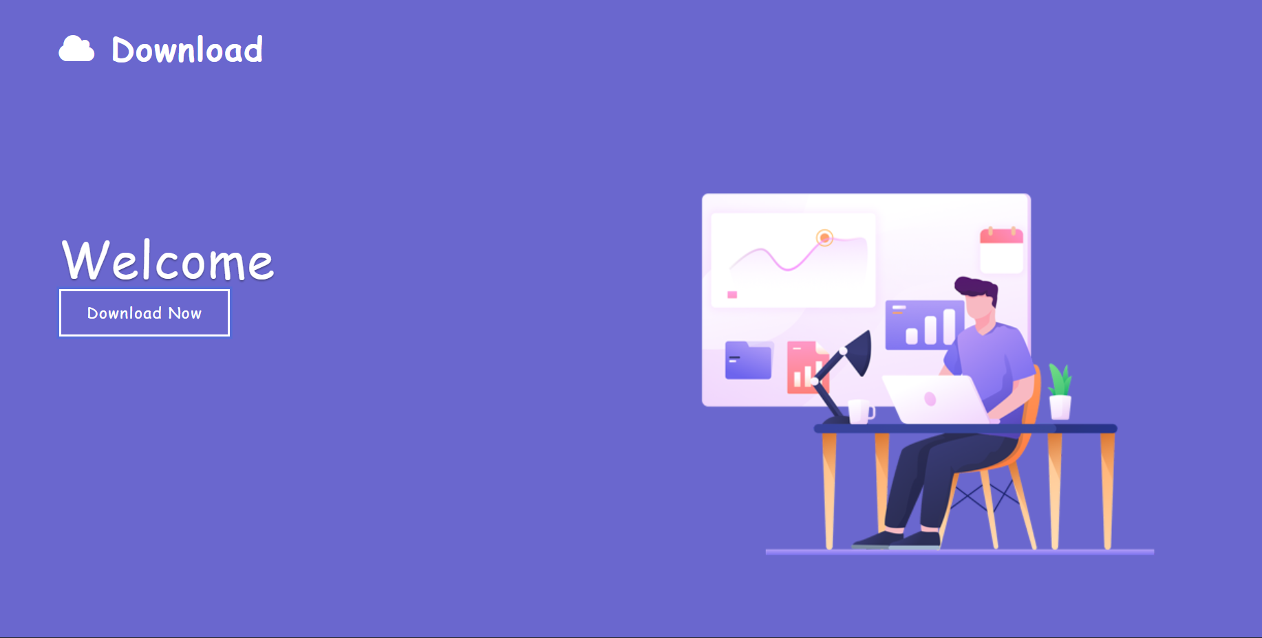

Slide 27
Thanks!
Any questions?

